Slide 1
CSS – Box Model

Slide 2
Box Model Every document element displayed on the web browser is written inside a box. Every box has a size, position, color, background color, border size, content height, content width, padding size, margin size and many more. These information of the box is determined by the CSS.
Margin
Border
Padding
Content

Slide 3
Each box is featured into four parts; - Margin Edge: The space outside the border is that acts as a separator between the neighboring element contents. They have margin-width, margin-height, and margin-size as the properties. - Border Edge: This is space surrounding the padding edge which acts as a border for the element content. They have properties such as border-width, border-height and border-thickness. - Padding Edge: The free space around the content data and it has properties such as padding-width, padding-height and padding-thickness. - Content Edge: where the text, videos and images are displayed. They have properties such as height, width, background color or image.
Box Model

Slide 4
Eg: div { margin: 10px 10px 20px 20px; // margin top, right, bottom, left height: 30px; weight: 20 px; border: 25 px; padding: 30px 40px 50px 60 px; background-color: yellow; } The four pixel values of margin and padding shows the top, right, bottom and left spacing. When only three values are given (margin: 10px 20px 30px;) then it refers to top, left as well as right, and bottom spacing. When only two values are given (margin: 10px 20px;) then the first value refers to top as well bottom spacing and the second refers to left as well right. When only one value is given (margin: 20px;) then all the four takes the same spacing.
Box Model

Slide 5
The border-radius is basically used to bring out a shape for the border i.e., a rounded corner or a circular corner, where the radius is half the value of the width value. There are four combinations of the border-radius; { border-top-left-radius: 10px; border-top-right-radius: 15px; border-bottom-left-radius: 10px; border-bottom-right-radius; 15px; } We also can assign a style for the border by selecting it to be dotted, solid, double, dashed, groove, ridge, inset , outset, none and hidden. Note: We need to understand that the height and width set for the element represents only the height and width of the content and not of the box elements. The complete height or width of the element will be the summation of the heights of all the four box model component. height = content height + border height + padding height + margin height

Slide 6
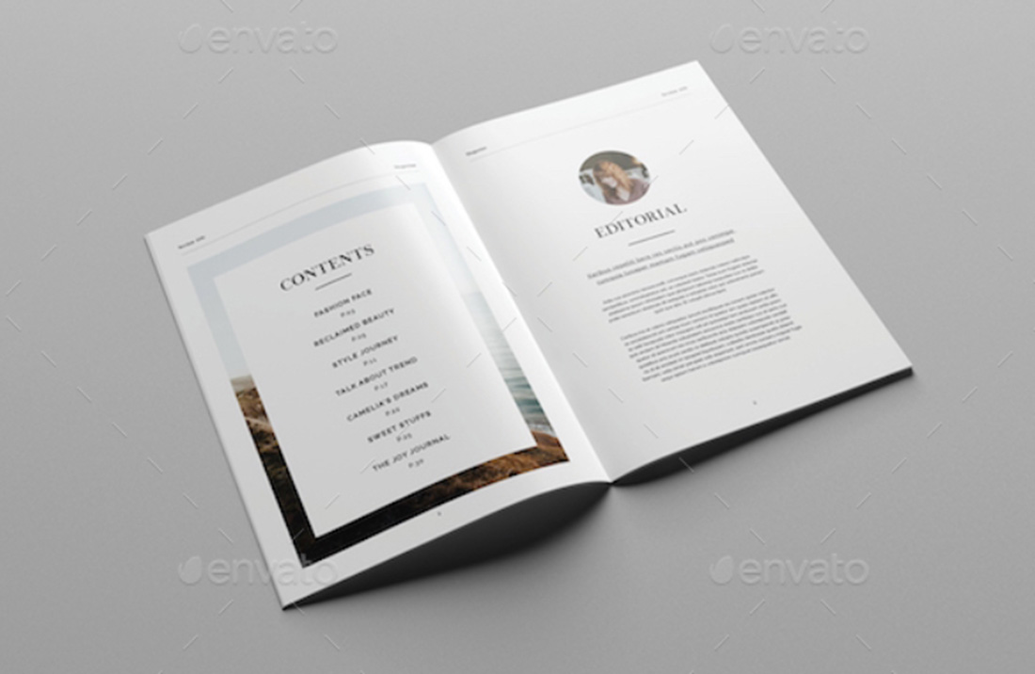

Slide 7
dotted - gives a dotted border dashed - gives a dashed border solid - gives a solid border double - gives a double border groove - gives a 3D grooved effect which depends on the border-color ridge - gives a 3D ridged border which depends on the border-color inset - gives a 3D inset border which depends on the border-color outset - gives a 3D outset border which depends on the border-color none - shows no border hidden - shows a hidden border The border-style property can be one or different four values (each referring the border for the top border, right border, bottom border, and the left border).

Slide 8
Backgrounds CSS background is used to represent the elements background effects like color, image, gradient, size, repetition and position. There are various properties of background namely; - background-color - background-gradient // new type added in CSS3 - background-image (single/multiple) - background-attachment - background-size - background-repeat (repeat-x, repeat-y, no-repeat) - background-attachment (fixed, scroll) - background-position(left top, left center, left bottom, right top, right center, right bottom, center top, center center, center bottom)

Slide 9
Background color: Here the color can be given as a text, hexadecimal, rgb value, or HSL
div
{ background-color: yellow;
background-color: #0000ff;
background-color: rgb(20,20,20);
background-color: hsl(170, 40%,60%);
}
HSL stands for Hue (ranging between 0-360), Saturation and Lightness (ranging between 0-100%)
Background gradient: There are two categories of gradients, linear gradient and radial gradient. They have the direction, and colors to be used for gradient as parameter.
The directions can have the values as to top, to bottom, to right, to left, to diagonal, angle etc.,

Slide 10
Eg: { background: linear-gradient(to right, yellow, blue, red); background: radiant-gradient(yellow 3%, blue 10%, red 12%); background: radiant-gradient(ellipse, yellow, blue, red); background: radiant-gradient(closest-side at 40% 60%, yellow, blue, red); } The gradient size can be any of the four categories; - farther-side - closest-side - closest-corner - farthest-corner

Slide 11
div { background: url(image.jpg); background-size: 150px 100px; background-repeat: no-repeat; background-image: url(image1.jpg), url(image2.jpg), url(image3.jpg); background-position: right top/ left top/ left bottom…; background-repeat: repeat / norepeat / repeat-y / repeat-x; background-attachment: fixed / scroll / local / initial / inherit; } repeat can be done vertically or horizontally which is denoted by repeat-x and repeat-y.

Slide 12
Text effects
Text Color
The color property is used to set the color of the text.
With CSS, a color is most often specified by:
a color name - like "red"
a HEX value - like "#ff0000"
an RGB value - like "rgb(255,0,0)"

Slide 13
Text Alignment
The text-align property is used to set the horizontal alignment of a text.
A text can be left or right aligned, centered, or justified.

Slide 14
Text Decoration
The text-decoration property is used to set or remove decorations from text.

Slide 15
Text Transformation
The text-transform property is used to specify uppercase and lowercase letters in a text.

Slide 16
Text Indentation
The text-indent property is used to specify the indentation of the first line of a text:
p { text-indent: 30px; }

Slide 17
Letter Spacing
The letter-spacing property is used to specify the space between the characters in a text.
h1 { letter-spacing: 2px; } h2 { letter-spacing: -2px; }

Slide 18
Line Height
The line-height property is used to specify the space between lines

Slide 19
Text Direction
The direction property is used to change the text direction of an element

Slide 20
Word Spacing
The word-spacing property is used to specify the space between the words in a text.
h1 {
word-spacing: 20px;
}
h2 {
word-spacing: -2px;
}

